Slide 1


Slide 2

What is this?

Slide 3

Are you sure?

Slide 4

So what is this?

Slide 5
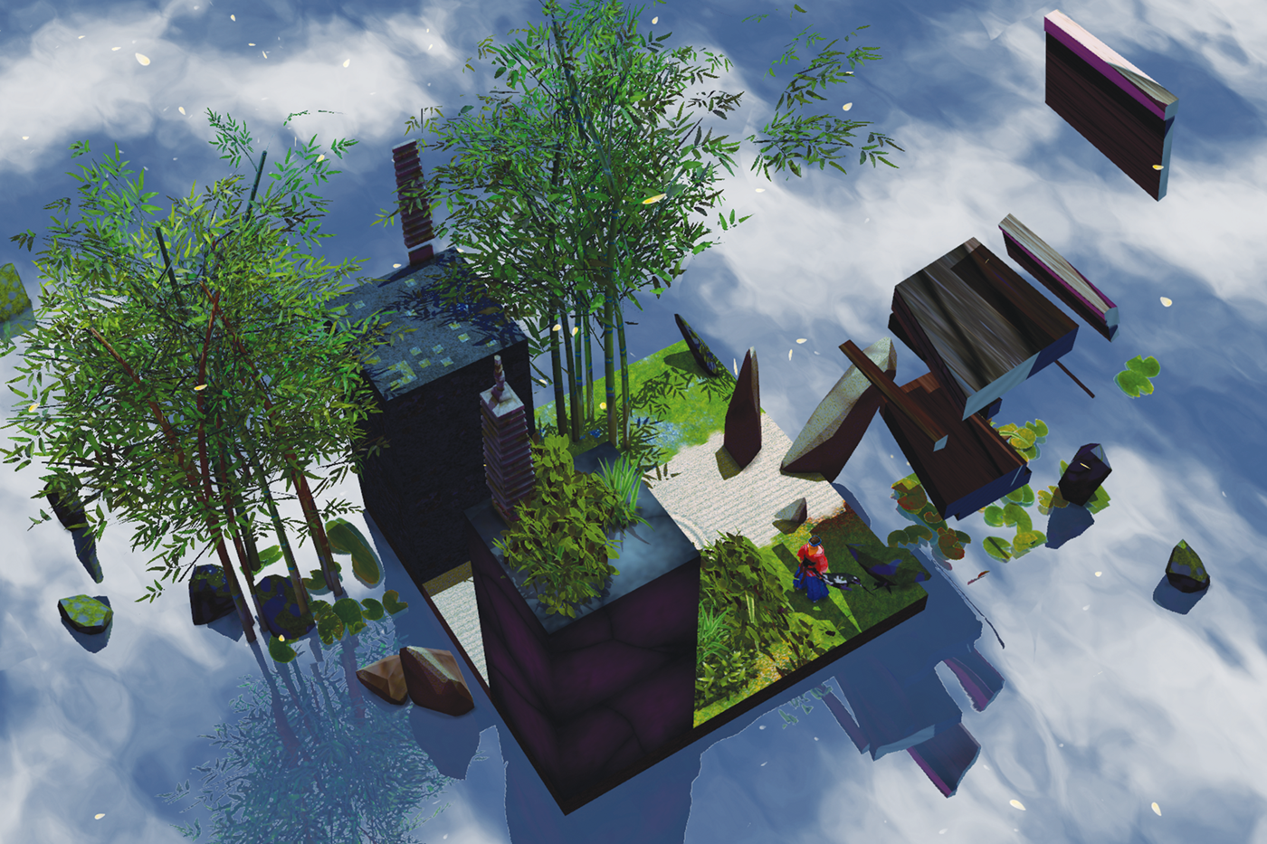
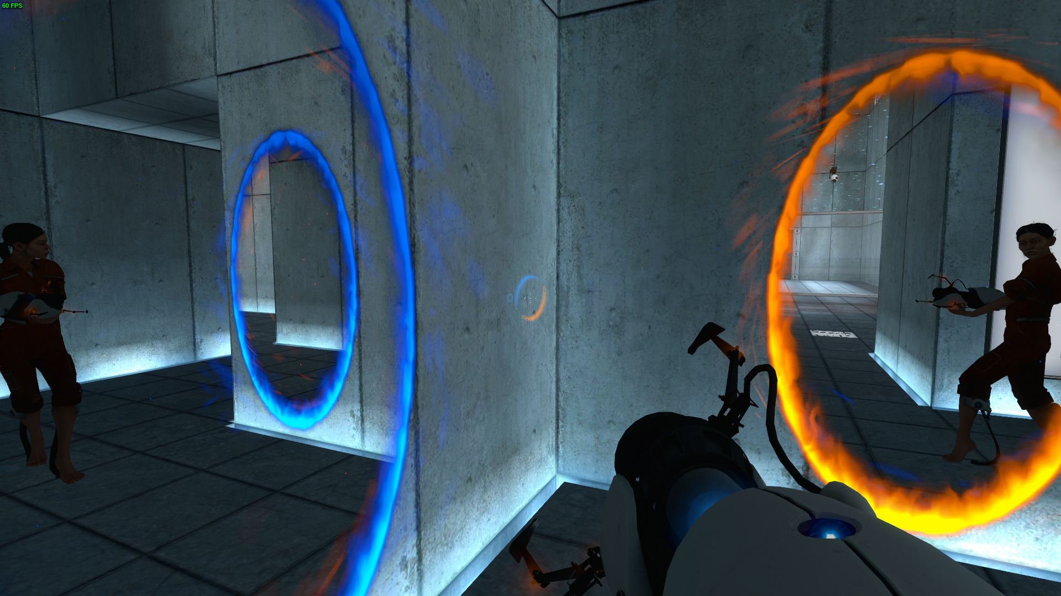
The proposal
+

